Slide 1
SHIVAJIRAO KADAM INSTITUTE OF TEACHNOLOGY AND MANAGMENT
ONLINE BOOK STORE
Guided By – Submitted By -
Prof. Deepa Vyas Nirmal Sen
0875CS171094
Kirtish Ajmera
0875CS171068
Purvi Bhawsar
0875CS171109
Kushal vaishnav
0875CS1710773

Slide 2
Introduction
An online bookstore software projects that acts as a central database containing various books in stock along with their title, author and cost. This project is a website that acts as a central book store.
This web project is developed using php as the front and python as an back end.
The sql database stores various book related details.
The user may even search for specific books on the website. Once the user selects a book,he then has to fill a form and the book is booked for the user.

Slide 3
PROBLEM DOMAIN
Problem identification :
This project aims to develop an online shopping facility for customers with the goal so that it is very easy to shop your loved books from these particular platform . With the help of this you can carry out an online shopping from your home . Here is no compelling reason to go to the croweded stores or shopping centres during festivals seasons or examination . You simply require a PC or laptop or your own personal mobile and one important payment sending option to shop online .
Problem in existing system :
Time consuming.
Issues related to product quality .
Logistics related problem .
Hidden charges .
Payment issues .

Slide 4
SOLUTION DOMAIN
Suggested solution :
The online book store is an online web application where the customer can purchase books online . Through a web browser can purchase books online . Through a web browser the customer can search for a book by its title or author ,later can add to the shopping cart and finally purchase the books ,and a easy mode of getting the desired book of every profession
Purpose of project:
The purpose of the project is to manage the details of Books, stocks, order , payment .It manages all the information about Books bill , payment ,books .The project is totally built at administrative end and thus only the administrative is guaranteed the access.The purpose of the project is to build an application program to reduce the manual work , time saving ,stocks of book ,bills .It tracks the details about the customer ,order ,payment.

Slide 5
FUNCTIONAL REQUIREMENTS
Browse Books
An user logging into the site can browse through the books both by category or in a random manner.
View Details
An user can also view the details of the book(egprice,author) as well as a short excerpt from the book.
Add to Cart
The user can add the books of his choice to the shopping cart.
Make Payments
The user ultimately visits his cart and makes the payment.

Slide 6
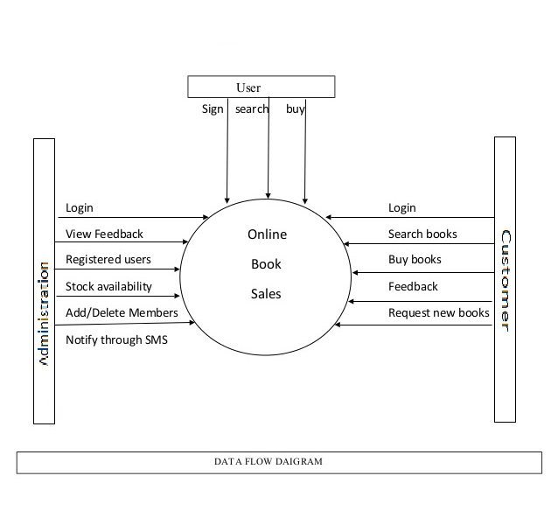
Data Flow Diagram

Slide 7
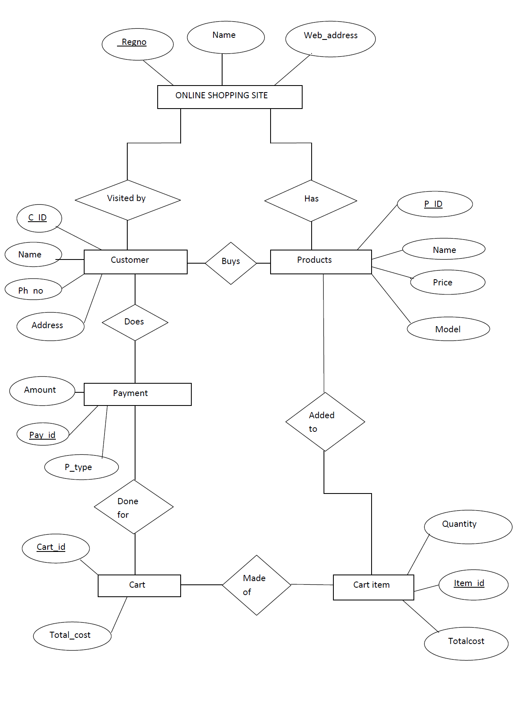
Entity-Relationship Diagram

Slide 8
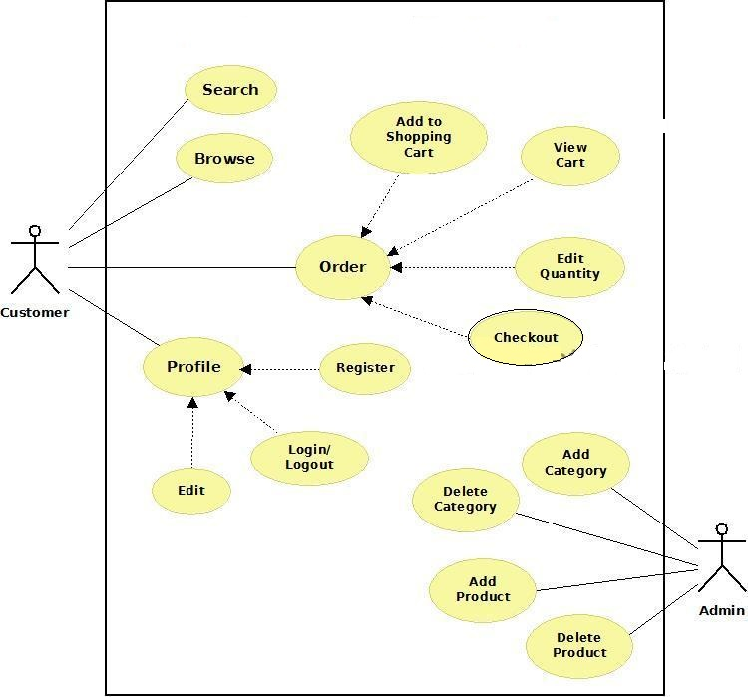
USE CASE DIAGRAM

Slide 9
Why Shop at Online Bookstores?
Shopping for books online helps you find the best possible price for just about any book you want. If you’re in the market for rare, collectible or autographed books, it’s much cheaper and faster to search online than it would be to call up local used and independent bookstores that carry these types of items.
The features available on many online bookstores also allow you to compare similar titles with the click of a mouse and read reviews from professionals and customers. You can also resell your used books to get more cash in your pocket and to clear out your cluttered bookshelf. It’s never been easier to ensure you never get stuck with a crummy title again.

Slide 10
THANK YOU

